Slide 1
Making D&D Accessible

Slide 2
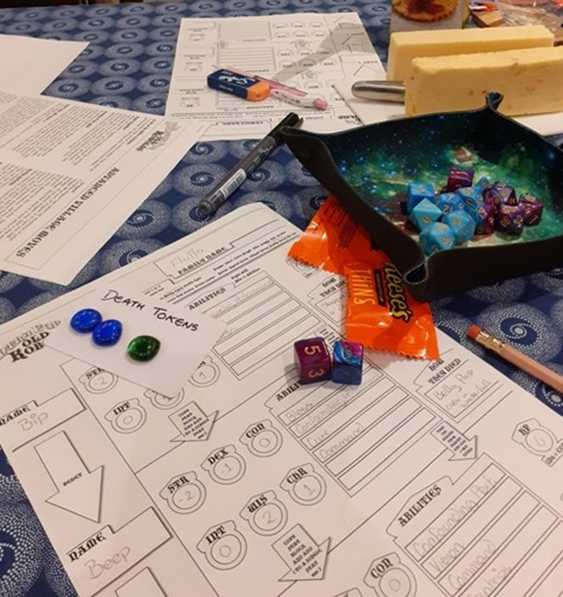
About Me - Laura
@Laura_GB
HatFullOfData.blog
HatFullOfData
Power BI Consultant

Slide 3
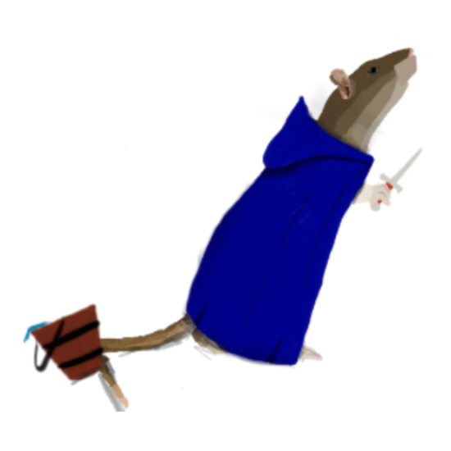
About Me - Ashley
@DyspraxicRogue
DyspraxicRogue.co.uk
Disability Advocate and Researcher

Slide 4

Outline
What is accessibility?
Storyboards for accessible UX
Storyboards to solutions
Let's Roll Some Dice

Slide 5

What is accessibility
?
?
?

Slide 6

Who is accessibility for?
EVERYONE
Even Dragons

Slide 7
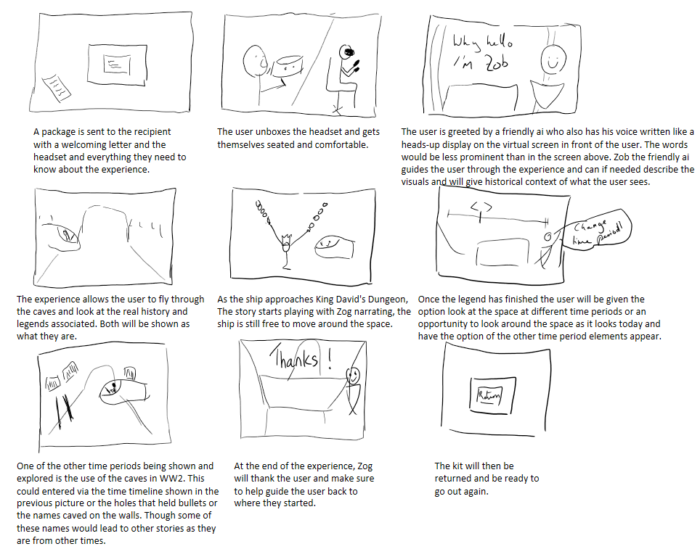
What is a storyboard

Slide 8
What currently happens

Slide 9
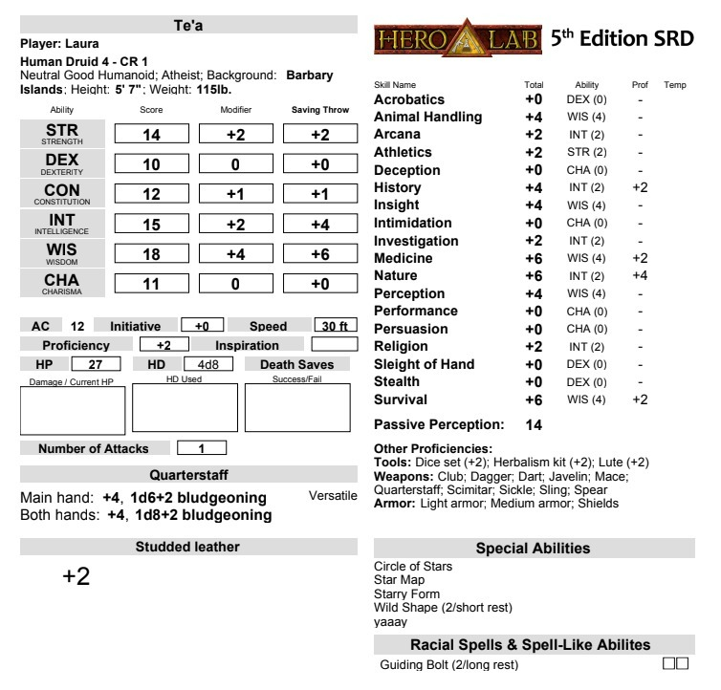
The problems

Slide 10
Change the storyboard

Slide 11
Requirements generated
Less information
Simple maths
Show what dice is needed

Slide 12

DEMO

Slide 13

Let’s roll initiative

Slide 14
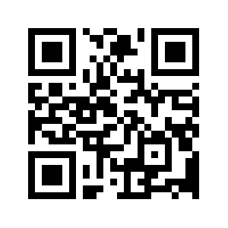
Feedback
https://sqlb.it/?9806

